Slide 1
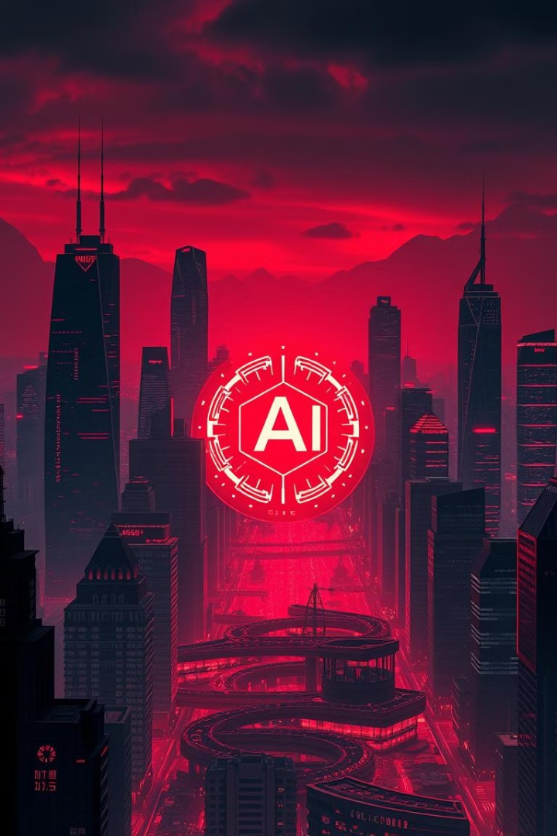
Harnessing the Power of Generative AI for Business Leaders
Join us as we delve into the transformative potential of Generative AI for business leaders. This presentation will equip you with the knowledge and insights to leverage this powerful technology and drive innovation in your organization.

Slide 2
Defining Generative AI: Concepts and Capabilities
The Essence
The Power
Generative AI is a subset of AI that creates new content, such as text, images, music, and code, based on existing data.
It harnesses algorithms and machine learning to generate realistic and original outputs, enabling creative solutions and automation.

Slide 3
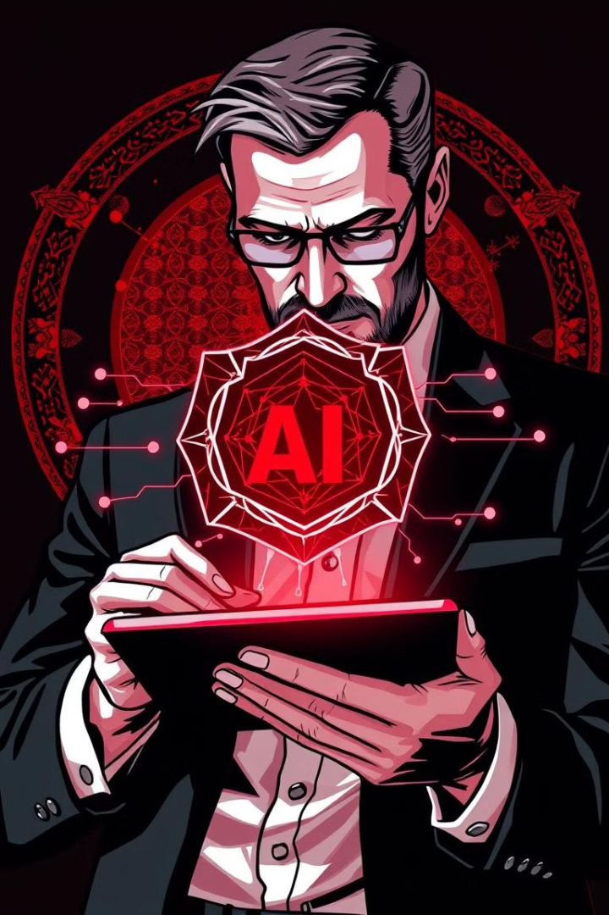
Uncovering the Business Value of Generative AI
Efficiency Gains
Enhanced Creativity
Automate repetitive tasks, freeing up time for strategic initiatives.
Generate novel ideas and designs, leading to innovation and differentiation.
Personalized Experiences
Data-Driven Decisions
Tailor products and services to individual customer needs and preferences.
Generate insights from complex datasets, enabling informed decision-making.

Slide 4
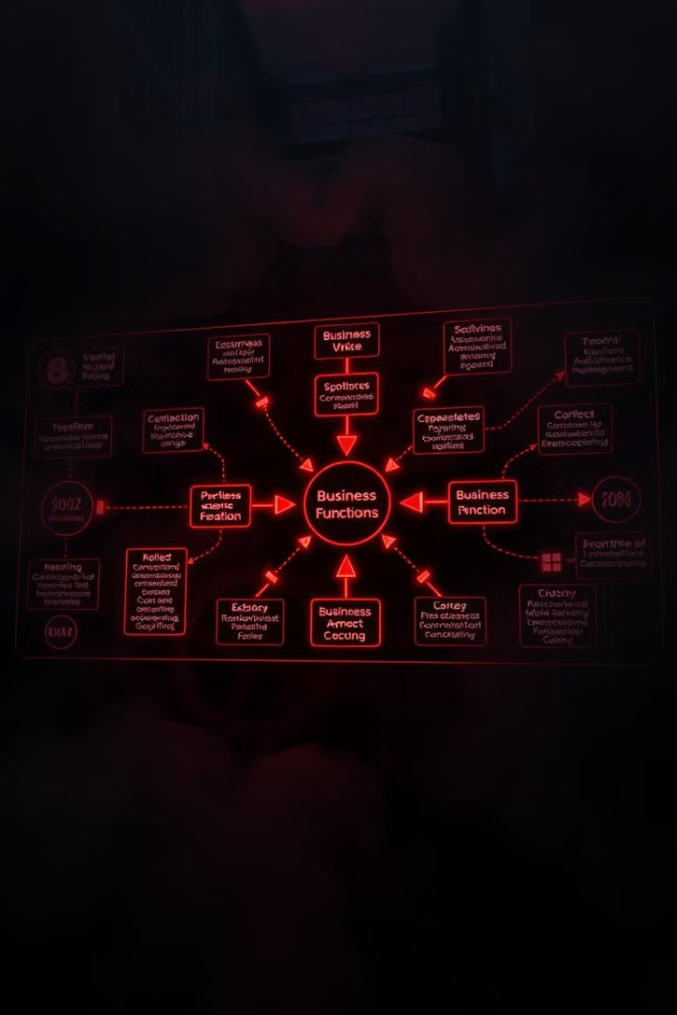




Applying Generative AI to Transform Key Business Functions
Marketing
Sales
Generate personalized content, automate social media posts, and optimize advertising campaigns.
Create targeted sales pitches, analyze customer data, and predict purchasing behavior.
Customer Service
Product Development
Develop chatbots for instant support, personalize responses, and resolve queries efficiently.
Generate innovative product ideas, optimize designs, and streamline product launch processes.

Slide 5





Navigating Ethical Considerations and Responsible AI Practices
Transparency
1
Explain AI decisions and ensure accountability.
Bias Mitigation
2
Address potential biases in data and algorithms.
Data Privacy
3
Protect sensitive data and comply with regulations.
Security
4
Safeguard AI systems from malicious attacks.
Human Oversight
5
Maintain human control and responsibility over AI systems.

Slide 6
Developing a Generative AI Strategy for Your Organization
Identify key business goals and pain points.
1
2
Explore relevant generative AI use cases and technologies.
Develop a pilot project to test the feasibility and value of AI.
3
4
Scale up AI adoption across key business functions.
Monitor progress, adapt the strategy, and drive continuous improvement.
5

Slide 7
Building an AI-Powered Innovation Pipeline
Idea Generation
1
Use AI to generate novel product ideas and solutions.
Concept Development
2
Develop prototypes and test ideas using AI-powered tools.
Market Validation
3
Analyze market trends and customer feedback using AI insights.
Launch and Iteration
4
Optimize products and services based on real-time data and feedback.

Slide 8





Upskilling Your Workforce for the Generative AI Era
AI Literacy
AI Skills Development
Collaboration and Teamwork
Ethical and Responsible AI
Educate employees on the fundamentals of AI and its applications.
Train employees in specific AI tools and techniques.
Foster a culture of collaboration between human and AI teams.
Instill a strong ethical framework for AI development and deployment.

Slide 9

Addressing Challenges and Overcoming Barriers to Adoption
1
2
Data Quality
Talent Acquisition
Ensure high-quality data for accurate AI outputs.
Hire and retain skilled AI professionals.
3
4
Cost and Investment
Integration Challenges
Allocate resources strategically for AI development and implementation.
Integrate AI systems seamlessly with existing business processes.

Slide 10



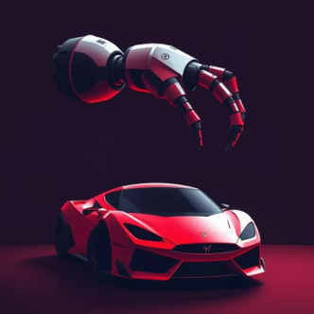

Future Trends and Emerging Opportunities in Generative AI

